Slide 1
MGI. LLC, PO Box 90, KYIV, 01024, UKRAINE EDRPOU 37599442, Sv. PDV 200067386, tel/fax: +38 044 227-07-88, mob: +38 097 595-42-77, email: info@mgi.llc email: office@mgi.llc web: http://mgi.llc | BANK OF BENEFICIARY: Kyiv Regional Directorate of Public Joint Stock Company Raiffeisen Bank Aval, SWIFT: AVALUAUKCKB Account number: 26004363826 EUR Account number: 26005363825 USD Account number: 26006363824 UAN

Slide 2
Normally, humates (leonardite) are produced from oxidized brown coal. Internationally accepted name of a soft lignite layer is leonardite.
Leonardite distinguishes from brown coal with higher oxidation level and more intense content of humic acids – up to 85%.
This kind of coal has poor calorific power that’s why it is usually raked up in dumps. It turns out that the principal sources of humic substances are wastes of brown coal extraction processes that perfectly matches the principles of green chemistry.
Humic preparations produced from coal have poor biological activity. Currently the humates produced from this kind of raw materials are represented at agricultural market mainly by powders. Such preparations have long effective time and are resistant to both heat in summer time and winter frosts.

Slide 3
Good quality of final products is determined by the following requirements for the leonardite used for humates manufacture:
Ash content – max 13%;
Mass concentration of mineral fraction not connected with humic acids – max 10%;
Mass concentration of humic acids – min 70%
And this is exactly what our company offers

Slide 4
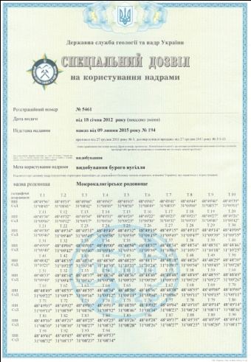
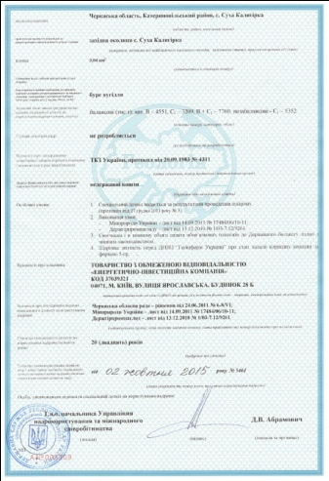
At present Energy Investment Company is the investor in power industry of Ukraine’s economics.
Using advanced technologies and applying upgrades promptly, the company transforms power-consuming projects into the new profitable courses of activity
Today EIC is the leading manufacturer of leonardite in Ukraine. The company’s share at the Ukrainian market is 95%.
At the end of 2011 EIC won an auction held by the State geology and natural resources administration and was licensed to use natural resources of brown coal deposit in Mokra Kalyhirka, Ukraine
The license term of validity is 20 years

Slide 5
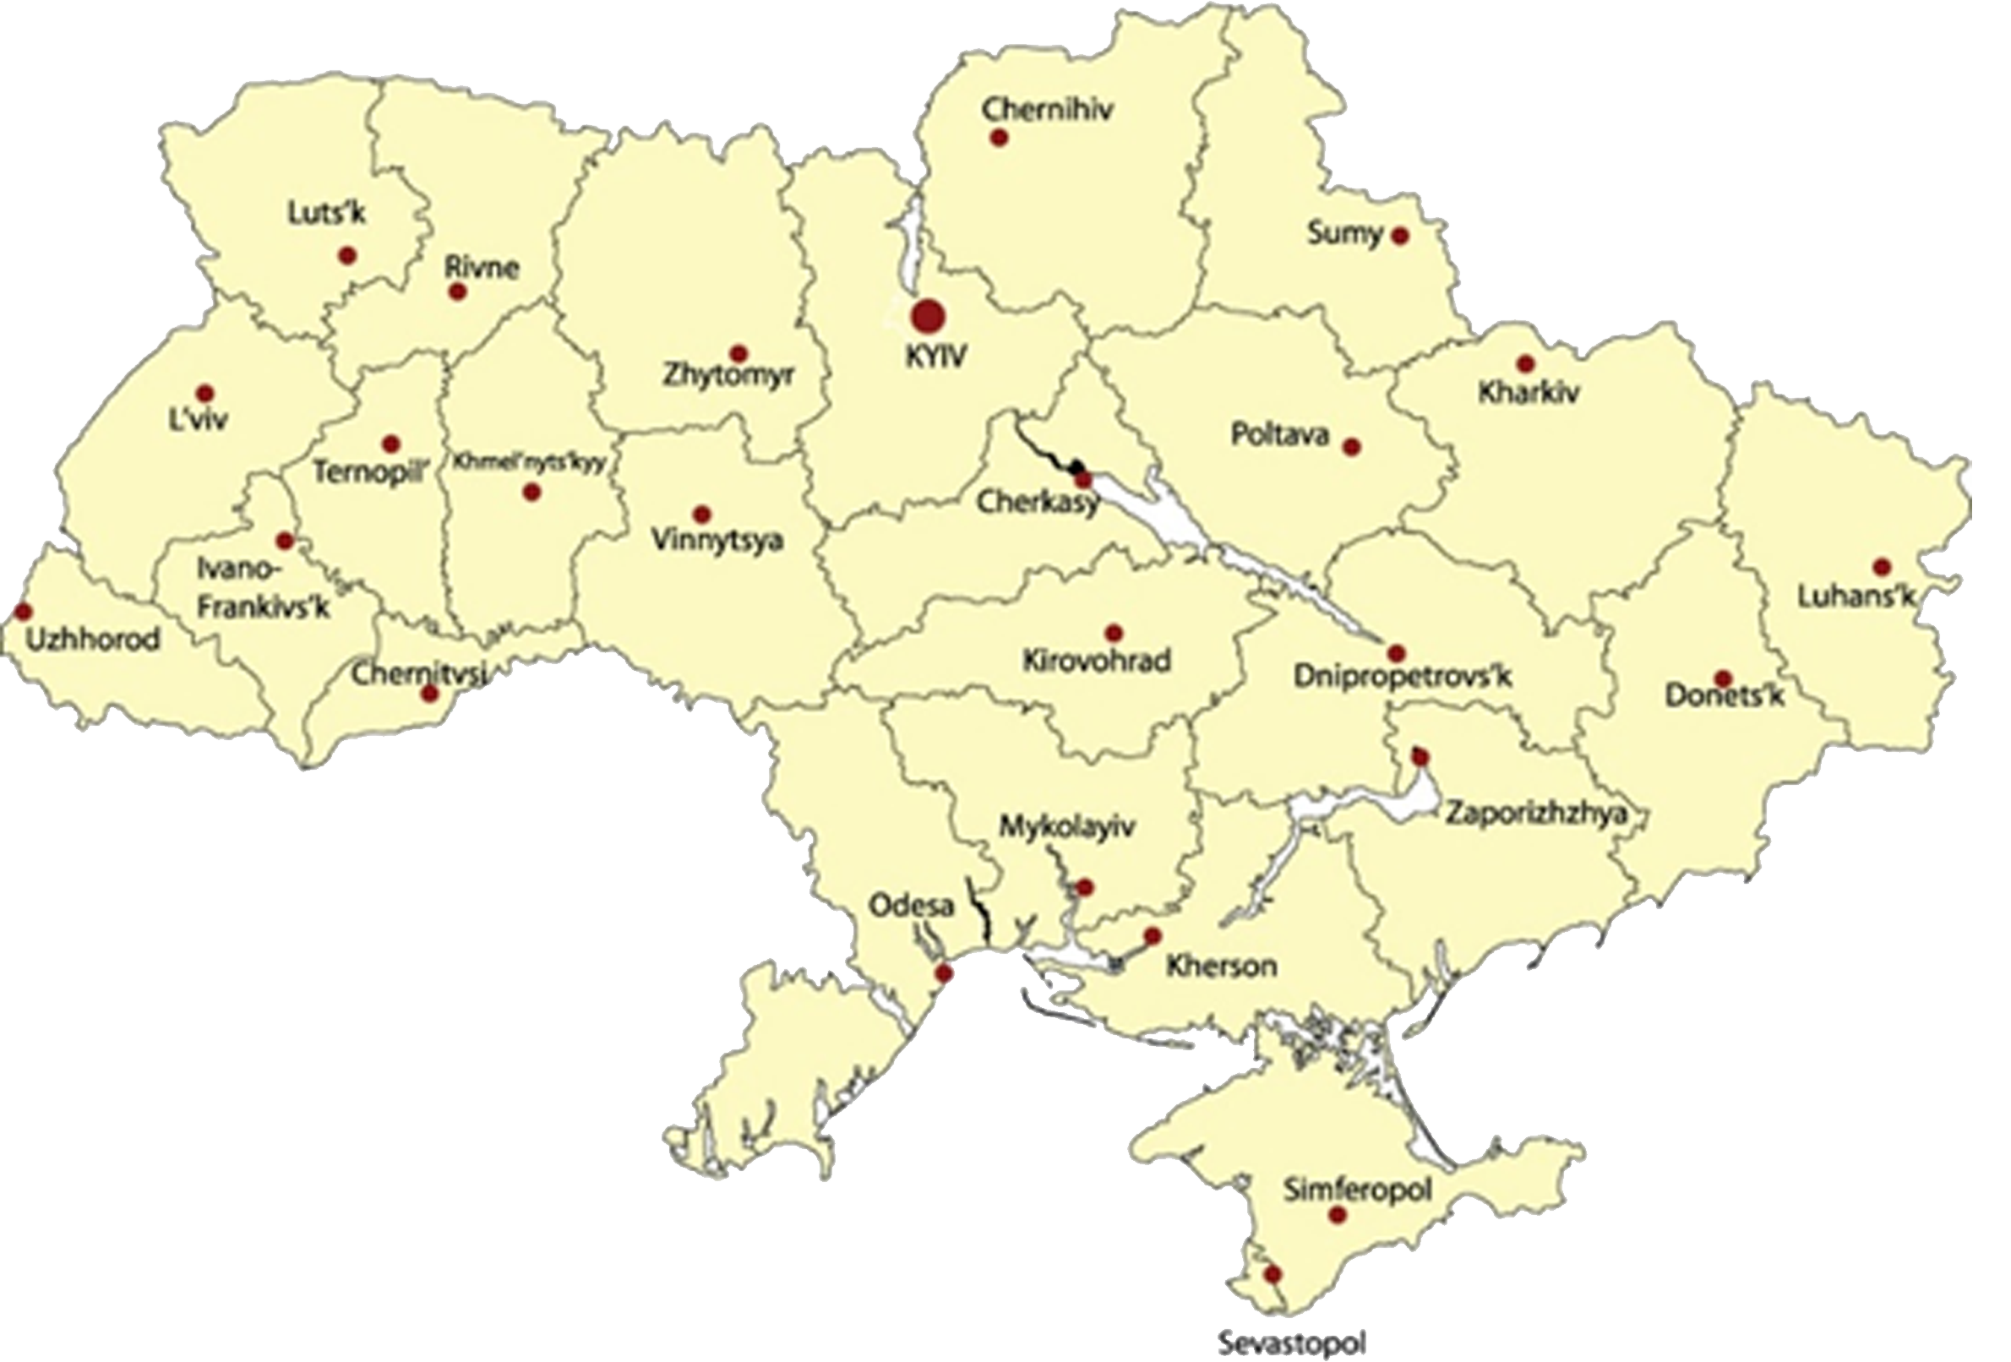
Mokra Kalyhirka lignite deposit is located in the central part of Dneprovskii brown coal (leonardite)basin (geological industrial region of Vatutinsk), Katerynopil district of Cherkassy region
Today this deposit is the primary resource of brown coal in Ukraine

Slide 6
the deposit Brown coal (leonardite) supplies are:
Reserves – 7,76 mill tons at stratum thickness of 3-11 meters;
Out of reserves – 5,40 mill tons at stratum thickness of 1-5 meters
Total brown coal (leonardite) supply is 13,16 mill tons
Operation life: 27 years
Area: 304,0 ha
Nominal production capacity is 300,0 thousands tons annually with possible increase to 600,0 thousands

Slide 7
Energy Investment Company
offers brown coal (leonardite) for production of the following kinds of fertilizers:
Sodium humate;
Potassium humate
Parameters of the brown coal (leonardite) offered:
Parameter | Value
Moisture (operational condition), % | 55,00
Ash, % (max) | 12,00
Acidity, рН | 6,40
Bitumen (damp ozocerite), % (min) | 15,00
Humic acids, % (min) | 79,60

Slide 8
Elemental composition of the brown coal (leonardite) offered
Content of harmful metals in brown coal ash:
Zn – 46,6 mcg/g of ash; Mn – 33,1 mcg/g; Cu – 27,6 mcg/g;
Ni – 16,9 mcg/g; Cd – 0,32 mcg/g; Pb – 17,7 mcg/g
Mercury and arsenic in ash – traces
Content of Fe is 3,42 mg/g of ash
The data prove the low content of heavy metals in the coal offered, and the most dangerous of them (mercury and arsenic) are traces only
N, % | С, % | S, % | Н, % | О, %
0,51 | 61,13 | 3,64 | 5,56 | 29,16

Slide 9
Advantages of using the leonardite offered by our company in fertilizers production:
Low cost price of fertilizers production;
High quality of the fertilizers produced owing to high content of humic acids in brown coal (leonardite);
High ecological compatibility of the fertilizers produced – brown coal(leonardite) fertilizers do not contain nitric and orthophosphoric acids;
Ability to use brown coal directly as fertilizer with no additional processing at consumption rate of 200 kg of brown coal (leonardite) for 1 ha of land;
Guaranteed and non-stop supply of brown coal (leonardite)

Slide 10
Delivery and payment:
Price of leonardite –___ EUR/ton at FOB Nikolaev, Ukraine;
Price of leonardite– ____ EUR/ton at CIF (Mediterranean);
Shipment within one working day after receiving of application
Supply capacity – up to 30 000 tens per month
Payment conditions – 100% advanced payment
According to expert assessments, the humates market in Ukraine is now passing the stage of forming. Under conditions of unavoidable growth of prices for import products and due to availability of domestic raw materials lots of experts believe this market be very promising.

Slide 11
Our company always welcomes dialogs and is willing to discuss any offer of cooperation including joint implementation of project focusing on creation of humates production from own raw materials
Thanks for your attention!
MGI. LLC, PO Box 90, KYIV, 01024, UKRAINE EDRPOU 37599442, Sv. PDV 200067386, tel/fax: +38 044 227-07-88, mob: +38 097 595-42-77, email: info@mgi.llc email: office@mgi.llc web: http://mgi.llc | BANK OF BENEFICIARY: Kyiv Regional Directorate of Public Joint Stock Company Raiffeisen Bank Aval, SWIFT: AVALUAUKCKB Account number: 26004363826 EUR Account number: 26005363825 USD Account number: 26006363824 UAN

